Slide 1
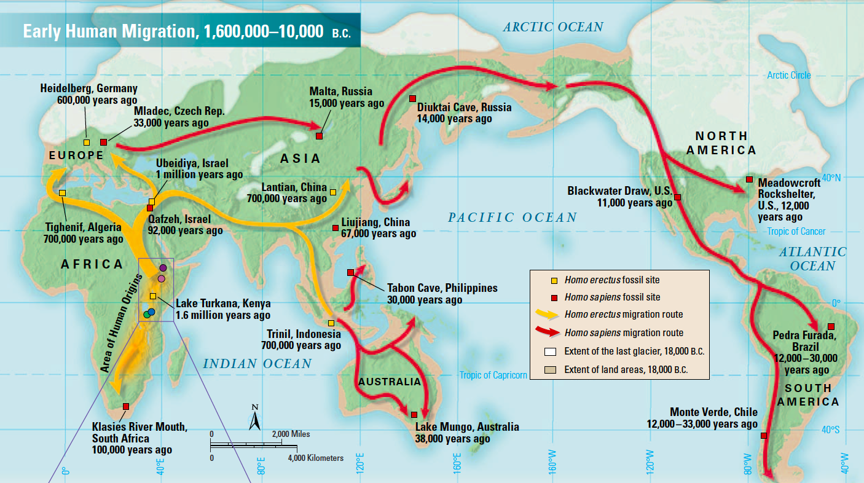
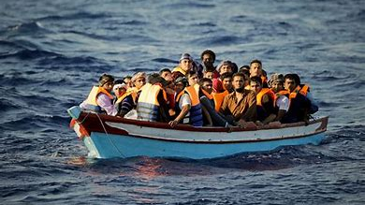
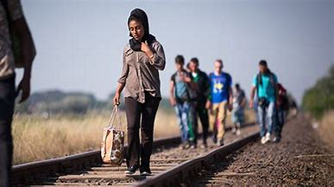
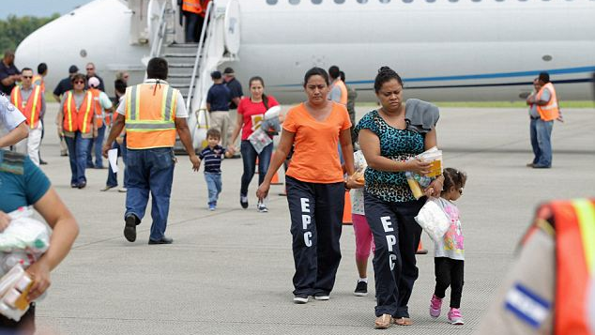
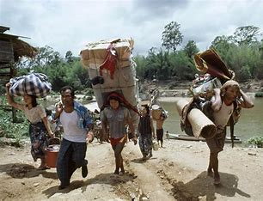
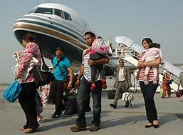
Knowledge Organiser: Year 6
Geography Spring 1
Careers connected to the human body:
doctor, nurse, massage therapist, personal trainer, theatre technician
Migration
Key Enquiries
People migrate from place to place for different reasons
Why do humans move?
KE: What is migration?
Population growth, rapid economic growth, overconsumption, farming, overexploitation, internal (within state/country), external (different state, country, continent), emigration, immigration (voluntary), return migration (temporary) and forced migration. climate change refugees
E2: Would life be different in another town/city or country?
E3: How do people migrate from one place to another?
Keywords
E4: Does everyone have a choice?
What migration looks like
National, Emigration, Temporary migrants, voluntary, emigration, temporary, immigration, permanent, international, environmental factors, religious persecution, cultural amenities, cultural norms, economic hardship, cultural discomfort, population factors, push, pull factors compelled to leave, mode of transport, ,indigenous, navigational, diversity, colonial, colonies, identity, reshaped, Source country (home country), great migration, displaced persons, asylum seeker, refugee, United Nations, stateless person, conflict
KE5: Will there ever be an end to migration?
Why do humans have a choice whether to move or not?

